Slide 1
Gotham Preventive Approach
Transformation Digital

Slide 2
Summary
Project presentation
Aspects to be addressed

Slide 3

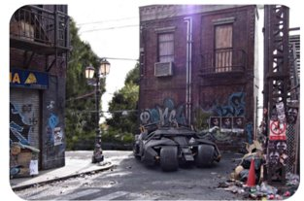

Project presentation

Slide 4
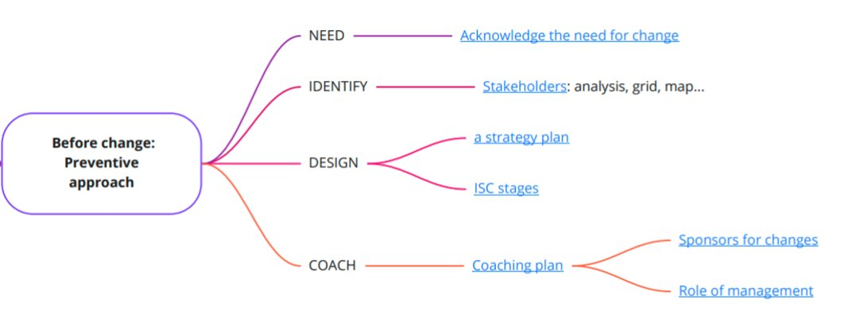
How to prepare for change

Slide 5
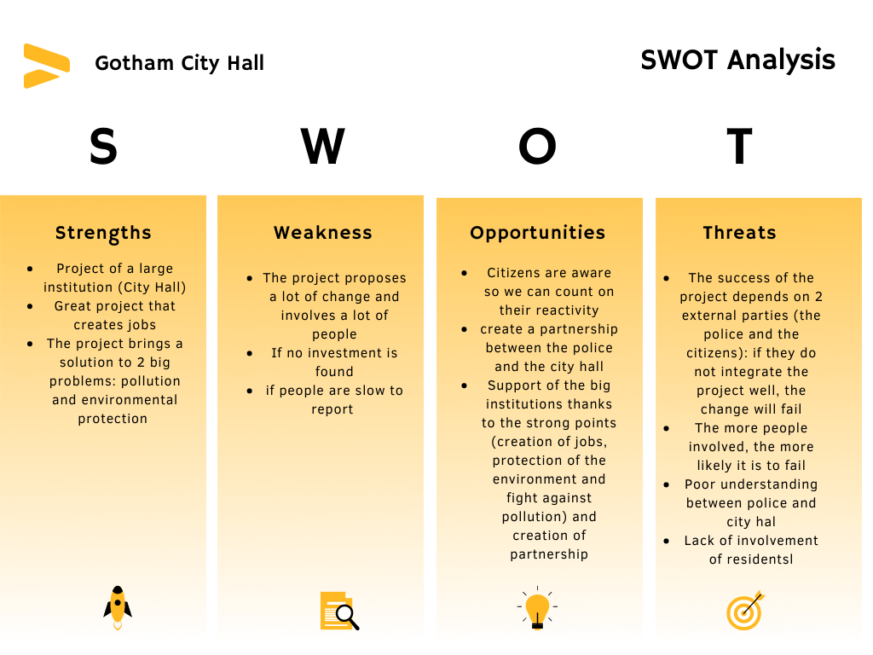
Need

Slide 6
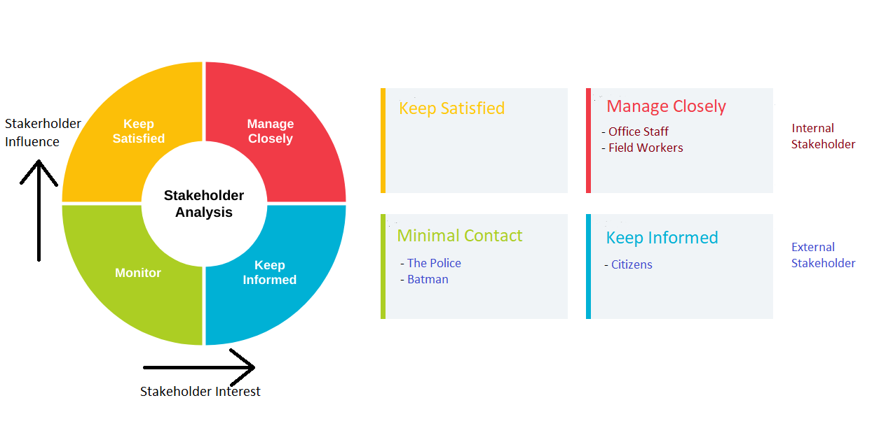
Identify

Slide 7
Design
Which actions our project will set.
Seven distincts actions.

Slide 8
Design : 7 actions
Improvement of Time Manager application.
Equip each SWAG's truck with GPS tracker.
Deployment of drones.
Equip employee(City Hall or SWAG) with communication tool.
Reduce citizen's trashcan volume and set up sensor inside.
Create a public mobile application.
Monthly meetings.

Slide 9
Design : oppositions and fears
Fear of general monitoring with use of drone and GPS tracker.
Possible rogue utilisation of mobile application.
Question the utility of these monthly meetings.

Slide 10
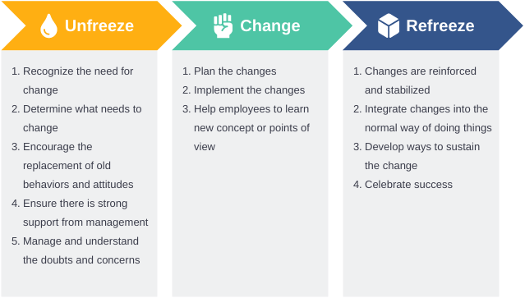
Coach

